Slide 1
SSIE 637
Advanced Topics in Healthcare
Lecture #4

Slide 2
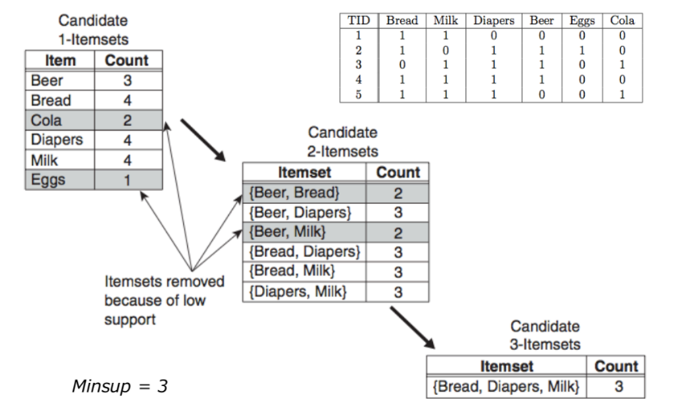
Data Mining with Rule Association: Apriori approach
Illustration of apriori algorithm

Slide 3
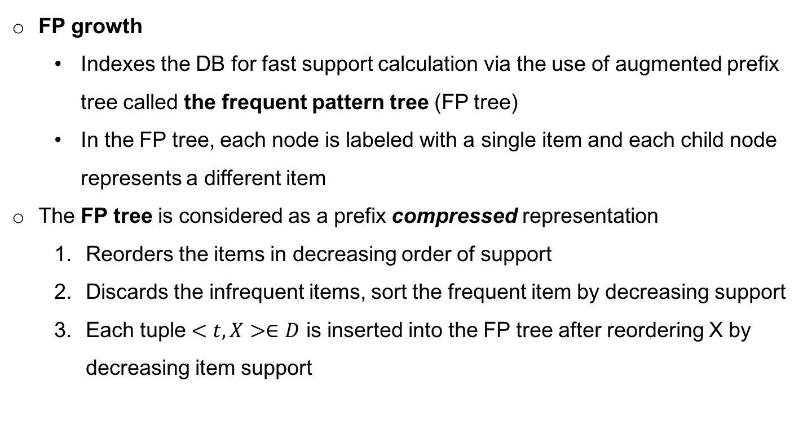
Data Mining with Rule Association: FP growth
FP growth
Indexes the DB for fast support calculation via the use of augmented prefix tree called the frequent pattern tree (FP tree)
In the FP tree, each node is labeled with a single item and each child node represents a different item
The FP tree is considered as a prefix compressed representation
Reorders the items in decreasing order of support
Discards the infrequent items, sort the frequent item by decreasing support
Each tuple $<t,X>∈D$ is inserted into the FP tree after reordering X by decreasing item support

Slide 4
Data Mining with Rule Association: FP growth
D | A | B | C | D | E
1 | 1 | 1 | 0 | 1 | 1
2 | 0 | 1 | 1 | 0 | 1
3 | 1 | 1 | 0 | 1 | 1
4 | 1 | 1 | 1 | 0 | 1
5 | 1 | 1 | 1 | 1 | 1
6 | 0 | 1 | 1 | 1 | 0
Delete infrequent item

Slide 5
Data Mining with Rule Association: FP growth
What are frequent itemset for C, A, and E from B?

Slide 6
Data Mining with Rule Association: FP growth

Slide 7
Data Mining with Rule Association: Application in Healthcare
AGE | Sex | Height | Weight | QRS duration | P-R interval | Q-T interval | T interval | P interval | QRS | Heart rate
75 | 0 | 190 | 80 | 91 | 193 | 371 | 174 | 121 | -16 | 13
56 | 1 | 165 | 64 | 81 | 174 | 401 | 149 | 39 | 25 | 37
54 | 0 | 172 | 95 | 138 | 163 | 386 | 185 | 102 | 96 | 34
55 | 0 | 175 | 94 | 100 | 202 | 380 | 179 | 143 | 28 | 11
75 | 0 | 190 | 80 | 88 | 181 | 360 | 177 | 103 | -16 | 13
13 | 0 | 169 | 51 | 100 | 167 | 321 | 174 | 91 | 107 | 66
40 | 1 | 160 | 52 | 77 | 129 | 377 | 133 | 77 | 77 | 49
49 | 1 | 162 | 54 | 78 | 0 | 376 | 157 | 70 | 67 | 7
44 | 0 | 168 | 56 | 84 | 118 | 354 | 160 | 63 | 61 | 69
50 | 1 | 167 | 67 | 89 | 130 | 383 | 156 | 73 | 85 | 34
62 | 0 | 170 | 72 | 102 | 135 | 401 | 156 | 83 | 72 | 71
45 | 1 | 165 | 86 | 77 | 143 | 373 | 150 | 65 | 12 | 37
54 | 1 | 172 | 58 | 78 | 155 | 382 | 163 | 81 | -24 | 42
30 | 0 | 170 | 73 | 91 | 180 | 355 | 157 | 104 | 68 | 51
44 | 1 | 160 | 88 | 77 | 158 | 399 | 163 | 94 | 46 | 20
47 | 1 | 150 | 48 | 75 | 132 | 350 | 169 | 65 | 36 | 45
47 | 0 | 171 | 59 | 82 | 145 | 347 | 169 | 61 | 77 | 75
46 | 1 | 158 | 58 | 70 | 120 | 353 | 122 | 52 | 57 | 49
Cardiac Arrhythmia data: Categorical Transformation
For example of Age
<40→1
41~50 →2
51~65 →3
>65 →4
For example of Heart Rate(HR)
<60→1
61~80 →2
81~100 →3
>100 →4
If Age=4 & HR=4 then,
Heart Disease???

Slide 8
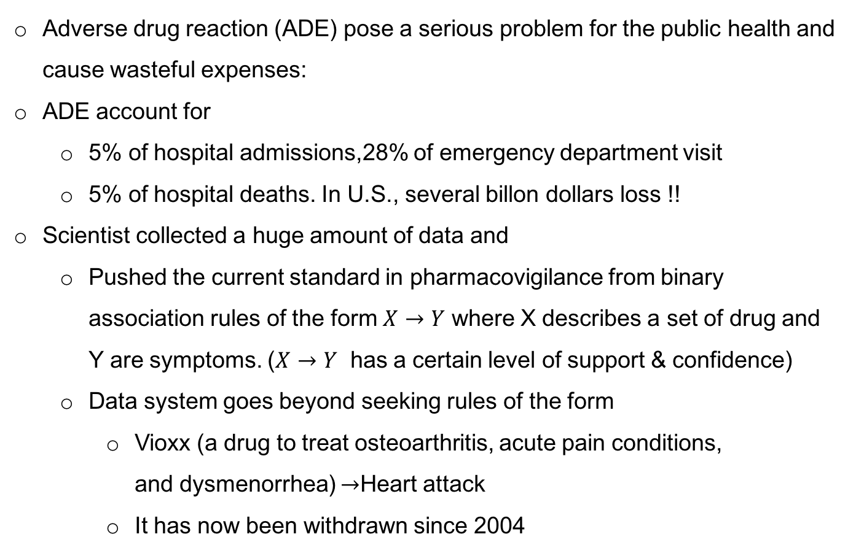
Data Mining with Rule Association: Application in Healthcare
Adverse drug reaction (ADE) pose a serious problem for the public health and cause wasteful expenses:
ADE account for
5% of hospital admissions,28% of emergency department visit
5% of hospital deaths. In U.S., several billon dollars loss !!
Scientist collected a huge amount of data and
Pushed the current standard in pharmacovigilance from binary association rules of the form $X→Y$ where X describes a set of drug and Y are symptoms. ($X→Y$ has a certain level of support & confidence)
Data system goes beyond seeking rules of the form
Vioxx (a drug to treat osteoarthritis, acute pain conditions, and dysmenorrhea) $→$Heart attack
It has now been withdrawn since 2004
Simovici, Dan A. "Data Mining of Medical Data: Opportunities and Challenges in Mining Association Rules." (2012).

Slide 9
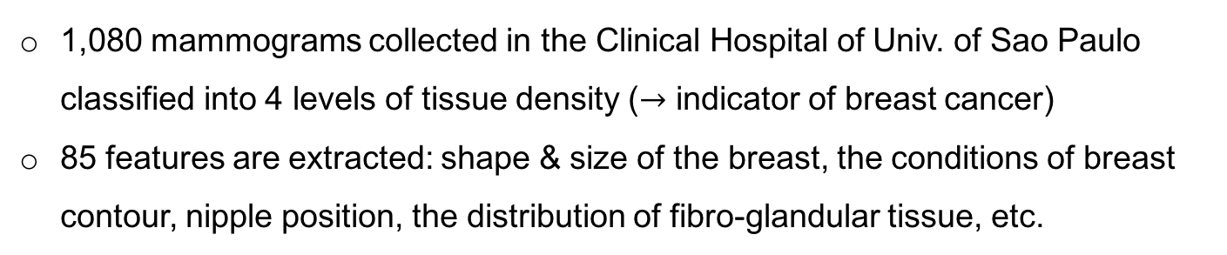
Data Mining with Rule Association: Application in Healthcare
1,080 mammograms collected in the Clinical Hospital of Univ. of Sao Paulo classified into 4 levels of tissue density ($→$ indicator of breast cancer)
85 features are extracted: shape & size of the breast, the conditions of breast contour, nipple position, the distribution of fibro-glandular tissue, etc.
Mined rule: 4th feature value in [0.1,0.3] tend to be images of malignant masses
>97% confidence level, 5% minsup
Ribeiro, Marcela Xavier, et al. "How to improve medical image diagnosis through association rules: The IDEA method." Computer-Based Medical Systems, 2008. CBMS'08. 21st IEEE International Symposium on. IEEE, 2008.

Slide 10
Data Mining with Rule Association: Application in Healthcare

Slide 11
Data Mining with Rule Association: Application in Healthcare
Age | Menopause | tumorsize | Inv-nodes | nodes-caps | deg-malig | breast | breast-quad | irradiat | classs
'40-49' | 'premeno' | '15-19' | '0-2' | 'yes' | '3' | 'right' | 'left_up' | 'no' | 'recurrence-events'
'50-59' | 'ge40' | '15-19' | '0-2' | 'no' | '1' | 'right' | 'central' | 'no' | 'no-recurrence-events'
'50-59' | 'ge40' | '35-39' | '0-2' | 'no' | '2' | 'left' | 'left_low' | 'no' | 'recurrence-events'
'40-49' | 'premeno' | '35-39' | '0-2' | 'yes' | '3' | 'right' | 'left_low' | 'yes' | 'no-recurrence-events'
'40-49' | 'premeno' | '30-34' | '3-5' | 'yes' | '2' | 'left' | 'right_up' | 'no' | 'recurrence-events'
'50-59' | 'premeno' | '25-29' | '3-5' | 'no' | '2' | 'right' | 'left_up' | 'yes' | 'no-recurrence-events'
'50-59' | 'ge40' | '40-44' | '0-2' | 'no' | '3' | 'left' | 'left_up' | 'no' | 'no-recurrence-events'
'40-49' | 'premeno' | '10-14' | '0-2' | 'no' | '2' | 'left' | 'left_up' | 'no' | 'no-recurrence-events'
'40-49' | 'premeno' | '0-4' | '0-2' | 'no' | '2' | 'right' | 'right_low' | 'no' | 'no-recurrence-events'
'40-49' | 'ge40' | '40-44' | '15-17' | 'yes' | '2' | 'right' | 'left_up' | 'yes' | 'no-recurrence-events'
'50-59' | 'premeno' | '25-29' | '0-2' | 'no' | '2' | 'left' | 'left_low' | 'no' | 'no-recurrence-events'
'60-69' | 'ge40' | '15-19' | '0-2' | 'no' | '2' | 'right' | 'left_up' | 'no' | 'no-recurrence-events'
'50-59' | 'ge40' | '30-34' | '0-2' | 'no' | '1' | 'right' | 'central' | 'no' | 'no-recurrence-events'
'50-59' | 'ge40' | '25-29' | '0-2' | 'no' | '2' | 'right' | 'left_up' | 'no' | 'no-recurrence-events'
'40-49' | 'premeno' | '25-29' | '0-2' | 'no' | '2' | 'left' | 'left_low' | 'yes' | 'recurrence-events'
'30-39' | 'premeno' | '20-24' | '0-2' | 'no' | '3' | 'left' | 'central' | 'no' | 'no-recurrence-events'
'50-59' | 'premeno' | '10-14' | '3-5' | 'no' | '1' | 'right' | 'left_up' | 'no' | 'no-recurrence-events'
'60-69' | 'ge40' | '15-19' | '0-2' | 'no' | '2' | 'right' | 'left_up' | 'no' | 'no-recurrence-events'
'50-59' | 'premeno' | '40-44' | '0-2' | 'no' | '2' | 'left' | 'left_up' | 'no' | 'no-recurrence-events'
'50-59' | 'ge40' | '20-24' | '0-2' | 'no' | '3' | 'left' | 'left_up' | 'no' | 'no-recurrence-events'
'50-59' | 'lt40' | '20-24' | '0-2' | nan | '1' | 'left' | 'left_low' | 'no' | 'recurrence-events'
'60-69' | 'ge40' | '40-44' | '3-5' | 'no' | '2' | 'right' | 'left_up' | 'yes' | 'no-recurrence-events'
'50-59' | 'ge40' | '15-19' | '0-2' | 'no' | '2' | 'right' | 'left_low' | 'no' | 'no-recurrence-events'
'40-49' | 'premeno' | '10-14' | '0-2' | 'no' | '1' | 'right' | 'left_up' | 'no' | 'no-recurrence-events'
'30-39' | 'premeno' | '15-19' | '6-8' | 'yes' | '3' | 'left' | 'left_low' | 'yes' | 'recurrence-events'
'50-59' | 'ge40' | '20-24' | '3-5' | 'yes' | '2' | 'right' | 'left_up' | 'no' | 'no-recurrence-events'
item: ("'premeno'",) , 0.524
item: ("'left'",) , 0.531
item: ("'no'", "'no-recurrence-events'", "'0-2'") , 0.566
item: ("'no-recurrence-events'", "'0-2'") , 0.584
item: ("'no'", "'no-recurrence-events'") , 0.643
item: ("'no-recurrence-events'",) , 0.703
item: ("'no'", "'0-2'") , 0.724
item: ("'0-2'",) , 0.745
item: ("'no'",) , 0.881
------------------------ RULES:
Rule: ("'no-recurrence-events'",) ==> ("'no'",) , 0.915
Rule: ("'no-recurrence-events'", "'0-2'") ==> ("'no'",) , 0.970
Rule: ("'0-2'",) ==> ("'no'",) , 0.972
Minsup 0.5
Minconf 0.9

Slide 12
Data Mining with Rule Association: Application in Healthcare
Only consider non-recurrence events instances ( = 85)
item: ("'premeno'",) , 0.507
item: ("'2'",) , 0.507
item: ("'no-recurrence-events'", "'premeno'") , 0.507
item: ("'2'", "'no-recurrence-events'") , 0.507
item: ("'left'",) , 0.512
item: ("'left'", "'no-recurrence-events'") , 0.512
item: ("'no'", "'0-2'") , 0.806
item: ("'no'", "'no-recurrence-events'", "'0-2'") , 0.806
item: ("'0-2'",) , 0.831
item: ("'no-recurrence-events'", "'0-2'") , 0.831
item: ("'no'",) , 0.915
item: ("'no'", "'no-recurrence-events'") , 0.915
item: ("'no-recurrence-events'",) , 1.000
------------------------ RULES:
Rule: ("'0-2'",) ==> ("'no'",) , 0.970
Rule: ("'0-2'",) ==> ("'no'", "'no-recurrence-events'") , 0.970
Rule: ("'no-recurrence-events'", "'0-2'") ==> ("'no'",) , 0.970
Rule: ("'no'",) ==> ("'no-recurrence-events'",) , 1.000
Rule: ("'0-2'",) ==> ("'no-recurrence-events'",) , 1.000
Rule: ("'premeno'",) ==> ("'no-recurrence-events'",) , 1.000
Rule: ("'left'",) ==> ("'no-recurrence-events'",) , 1.000
Rule: ("'2'",) ==> ("'no-recurrence-events'",) , 1.000
Rule: ("'no'", "'0-2'") ==> ("'no-recurrence-events'",) , 1.000

Slide 13
Data Mining with Rule Association: Application in Healthcare
Only consider recurrence events instances ( = 201)
item: ("'3'",) , 0.529
item: ("'no'", "'0-2'") , 0.529
item: ("'3'", "'recurrence-events'") , 0.529
item: ("'no'", "'0-2'", "'recurrence-events'") , 0.529
item: ("'0-2'",) , 0.541
item: ("'yes'",) , 0.541
item: ("'0-2'", "'recurrence-events'") , 0.541
item: ("'yes'", "'recurrence-events'") , 0.541
item: ("'premeno'",) , 0.565
item: ("'premeno'", "'recurrence-events'") , 0.565
item: ("'left'",) , 0.576
item: ("'left'", "'recurrence-events'") , 0.576
item: ("'no'",) , 0.800
item: ("'no'", "'recurrence-events'") , 0.800
item: ("'recurrence-events'",) , 1.000
------------------------ RULES:
Rule: ("'premeno'",) ==> ("'recurrence-events'",) , 1.000
Rule: ("'0-2'",) ==> ("'recurrence-events'",) , 1.000
Rule: ("'left'",) ==> ("'recurrence-events'",) , 1.000
Rule: ("'no'",) ==> ("'recurrence-events'",) , 1.000
Rule: ("'yes'",) ==> ("'recurrence-events'",) , 1.000
Rule: ("'3'",) ==> ("'recurrence-events'",) , 1.000
Rule: ("'no'", "'0-2'") ==> ("'recurrence-events'",) , 1.000

Slide 14
Learning algorithm: Data Clustering

Slide 15
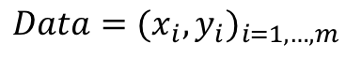
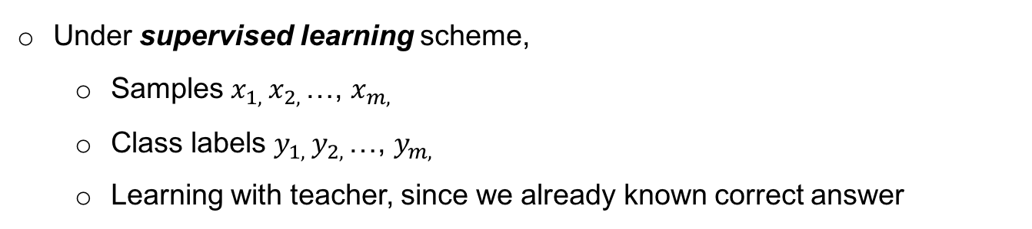
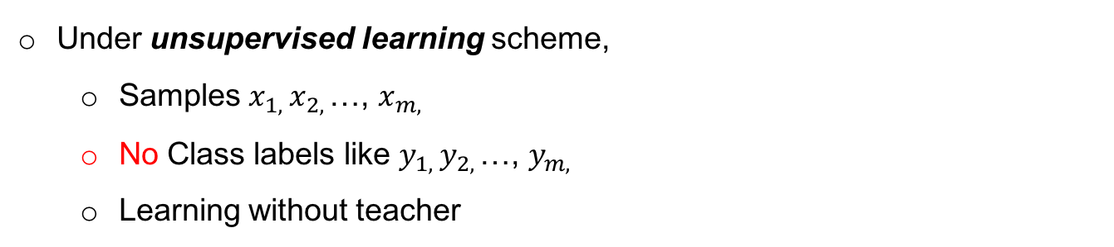
Learning algorithm: Supervised vs. Unsupervised Learning
Under supervised learning scheme,
Samples $x_{1, }x_{2, }$…, $x_{m, }$
Class labels $y_{1, }y_{2, }$…, $y_{m, }$
Learning with teacher, since we already known correct answer
$$Data=(x_{i},y_{i})_{i=1,…,m}$$
Under unsupervised learning scheme,
Samples $x_{1, }x_{2, }$…, $x_{m, }$
No Class labels like $y_{1, }y_{2, }$…, $y_{m, }$
Learning without teacher

Slide 16
Learning algorithm: Clustering
Clustering assigns similar objects together (=cluster) in order to discover structures in data that doesn't have any labels.
Good clustering?
Intra-cluster distances should be small ( → high similarity within group )
Inter-cluster distances should be large (→ low similarity between group)

Slide 17
Learning algorithm: Clustering
Resulting cluster evaluation ( How do we know if ours are meaningful???)
Seek ”natural” clusters in the data
Asking experts ( external evaluation)
Define an objective function on clustering ( internal evaluation, e.g., mean of similarity)

Slide 18
Learning algorithm: Clustering
Basic Steps
Determine the number of clusters
Define similarity
Define a criterion (evaluation) function for clustering
Define an algorithm (methodology) to minimize the criterion

Slide 19
Learning algorithm: Clustering
How many clusters to be determined??
Fix the number of clusters to k according to expert knowledge
Find the best clusters according to the criterion function
In terms of k, we have different clustering results

Slide 20
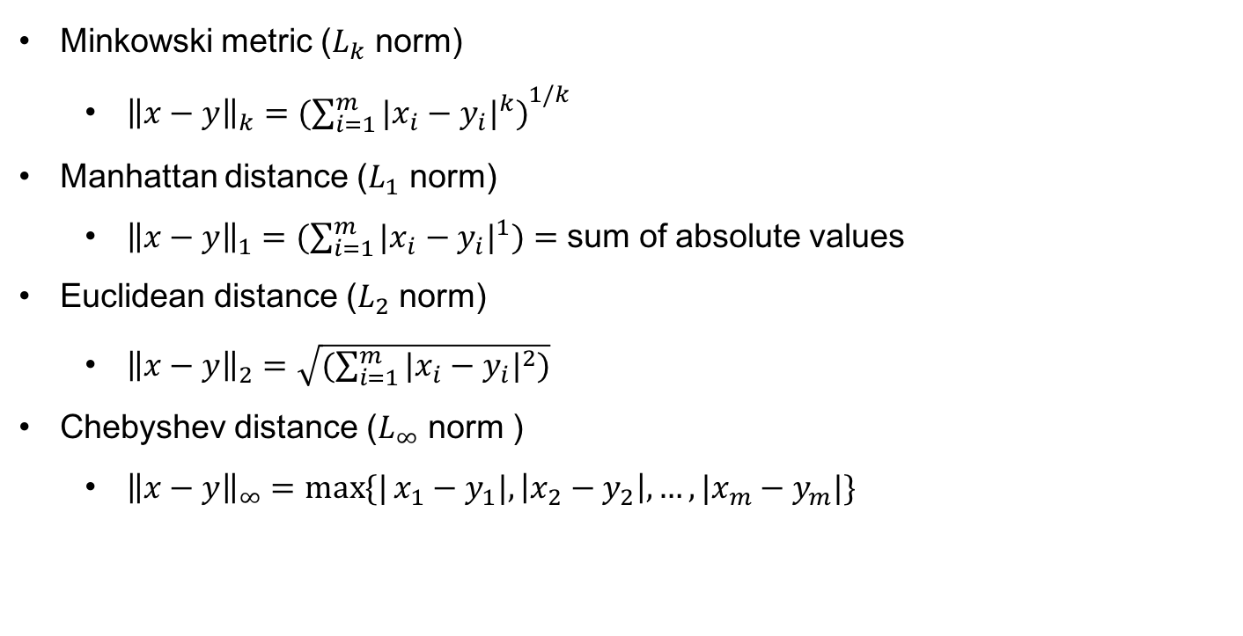
Learning algorithm: Clustering
Dissimilarity measurements
Distance based measurements ( A norm)
A norm is a function that assigns a strictly positive length or size to each vector in a vector space
Minkowski metric ($L_{k}$ norm)
${\left\|x−y\right\|}_{k}={(\sum_{i=1}^{m}{{|x_{i}−y_{i}|}^{k})}}^{1/k}$
Manhattan distance ($L_{1}$ norm)
${\left\|x−y\right\|}_{1}=(\sum_{i=1}^{m}{{|x_{i}−y_{i}|}^{1})=}$ sum of absolute values
Euclidean distance ($L_{2}$ norm)
${\left\|x−y\right\|}_{2}=\sqrt{(\sum_{i=1}^{m}{{|x_{i}−y_{i}|}^{2})}}$
Chebyshev distance ($L_{∞}$ norm )
${\left\|x−y\right\|}_{∞}=\max{\{|}x_{1}−y_{1}|, \left|x_{2}−y_{2}\right|,…,{|x}_{m}−y_{m}|\}$

Slide 21
Learning algorithm: Clustering
Other metrics
Quadratic distance
Canberra metric
The above distance metrics are measure of dissimilarity. Some measures of similarity also exist
Inner product
Correlation coefficient

Slide 22
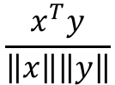
Learning algorithm: Clustering
Tanimoto measure (for binary valued vectors)
Mutual Information
Cosine similarity
$$\frac{x^{T}y}{\left\|x\right\|\left\|y\right\|}$$

Slide 23
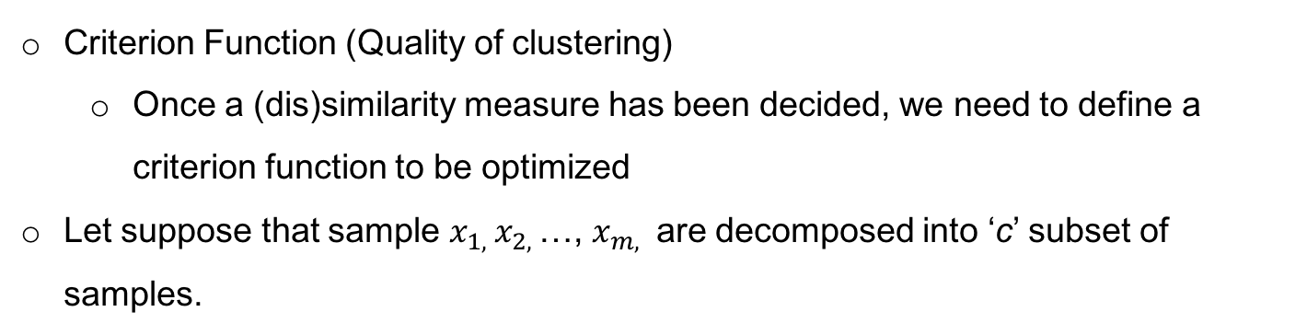
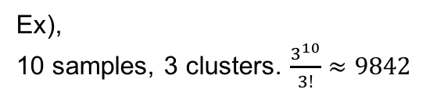
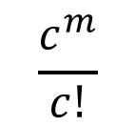
Learning algorithm: K-mean Clustering
Criterion Function (Quality of clustering)
Once a (dis)similarity measure has been decided, we need to define a criterion function to be optimized
Let suppose that sample $x_{1, }x_{2, }$…, $x_{m, }$ are decomposed into ‘c’ subset of samples.
How many decomposition can be made?
$$\frac{c^{m}}{c!}$$
Ex),
10 samples, 3 clusters. $\frac{3^{10}}{3!}≈9842$

Slide 24
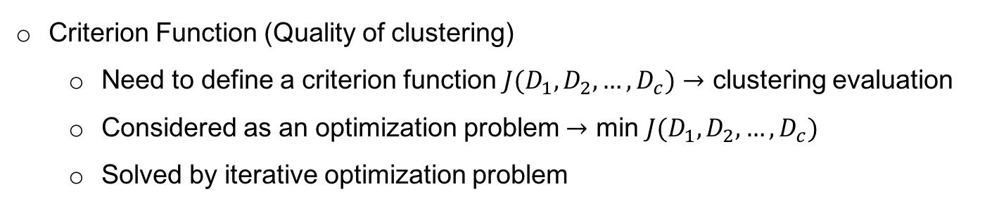
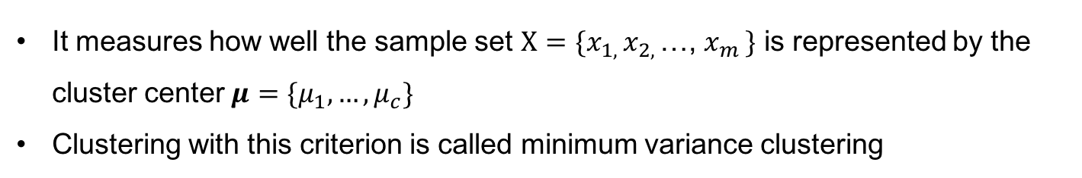
Learning algorithm: K-mean Clustering
Criterion Function (Quality of clustering)
Need to define a criterion function $J(D_{1},D_{2},…,D_{c})→$ clustering evaluation
Considered as an optimization problem $→$ min $J(D_{1},D_{2},…,D_{c})$
Solved by iterative optimization problem
The most widely used criterion is the sum of square error (SSE, MSE)
It measures how well the sample set $X=\{x_{1, }x_{2, }$…, $x_{m }\}$ is represented by the cluster center $μ=\{μ_{1},…,μ_{c}\}$
Clustering with this criterion is called minimum variance clustering

Slide 25
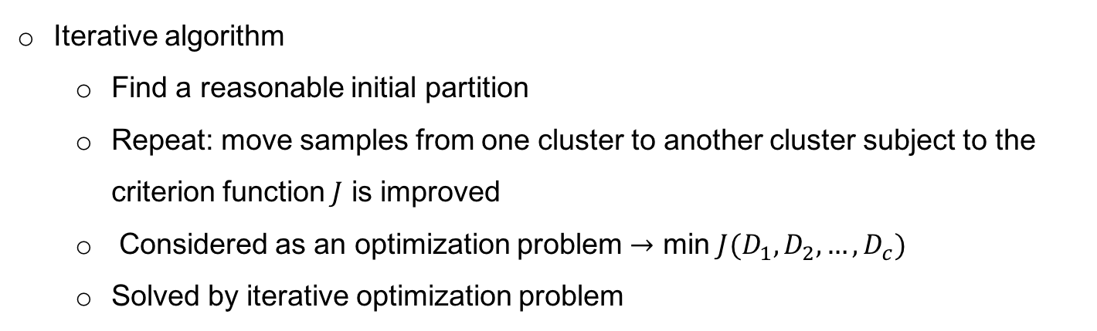
Learning algorithm: K-mean Clustering
Iterative algorithm
Find a reasonable initial partition
Repeat: move samples from one cluster to another cluster subject to the criterion function $J$ is improved
Considered as an optimization problem $→$ min $J(D_{1},D_{2},…,D_{c})$
Solved by iterative optimization problem

Slide 26
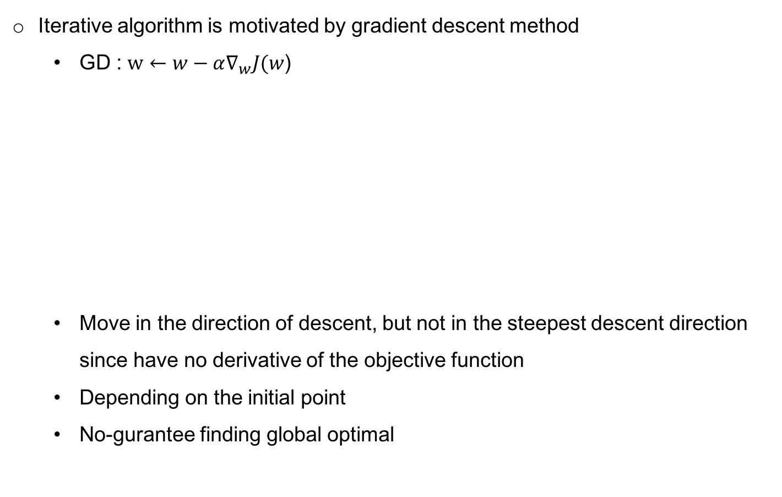
Learning algorithm: K-mean Clustering
Iterative algorithm is motivated by gradient descent method
GD : $w←w−α∇_{w}J(w$)
Move in the direction of descent, but not in the steepest descent direction since have no derivative of the objective function
Depending on the initial point
No-gurantee finding global optimal

Slide 27
Learning algorithm: K-mean Clustering

Slide 28
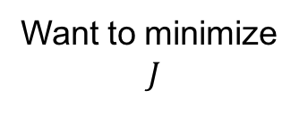
Learning algorithm: K-mean Clustering
More details in step 2 & 3
Why reassign?
Want to minimize
$$J$$

Slide 29
Learning algorithm: K-mean Clustering
Ex)
(a) Original data distribution
(b) Random initial centroid
(c-f) two iterations of k-mean clustering algorithm

Slide 30
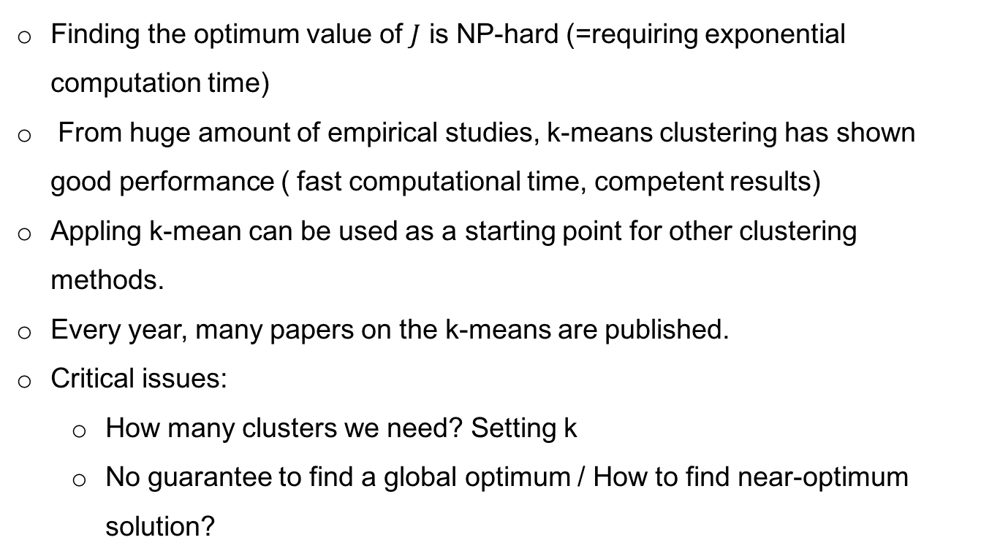
Learning algorithm: K-mean Clustering
Finding the optimum value of $J$ is NP-hard (=requiring exponential computation time)
From huge amount of empirical studies, k-means clustering has shown good performance ( fast computational time, competent results)
Appling k-mean can be used as a starting point for other clustering methods.
Every year, many papers on the k-means are published.
Critical issues:
How many clusters we need? Setting k
No guarantee to find a global optimum / How to find near-optimum solution?

Slide 31
Learning algorithm: K-mean Clustering
Python example
Using scikit-learn package
Data set: Iris (https://archive.ics.uci.edu/ml/datasets/Iris)
4 features ( sepal length, sepal width, petal length, petal width) 3 classes (setosa, versicolour, virginica)

Slide 32
Learning algorithm: K-mean Clustering
import numpy as np import matplotlib.pyplot as plt from mpl_toolkits.mplot3d import Axes3D from sklearn.cluster import KMeans from sklearn import datasets np.random.seed(5) centers = [[1, 1], [-1, -1], [1, -1]] iris = datasets.load_iris() X = iris.data y = iris.target estimators = {'k_means_iris_3': KMeans(n_clusters=3), 'k_means_iris_4': KMeans(n_clusters=4), 'k_means_iris_5': KMeans(n_clusters=5, n_init=1, init='random')}
for name, est in estimators.items(): fig = plt.figure(fignum, figsize=(8, 6)) plt.clf() ax = Axes3D(fig, rect=[0, 0, .95, 1], elev=48, azim=134) plt.cla() est.fit(X) labels = est.labels_ ax.scatter(X[:, 3], X[:, 0], X[:, 2], c=labels.astype(np.float))

Slide 33
Learning algorithm: K-mean Clustering
k=3
k=5
k=4
Ground-truth

Slide 34
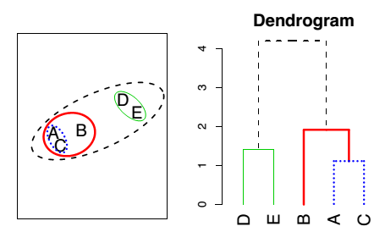
Learning algorithm: Hierarchical clustering
Hierarchical clustering is an alternative approach which does not require a choice of k (num. of clusters)
Basic steps of hierarchical clustering:
Start with each sample (data point) in its own cluster
Identify the closest two clusters and merge them
Repeat 2
Ends when all samples are in a single cluster
Bottom-up clustering

Slide 35
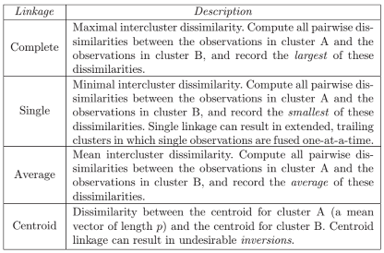
Learning algorithm: Hierarchical clustering
Draw conclusion of clusters based on vertical axis, but horizontal axis
The height of cut to the to the dendrogram serves the same role as the k mean clustering
Still no clear answer about the determination of the height
Linkage criteria
The linkage criterion determines the distance between sets of samples as a function of the pairwise distances between sample
I.e., how to determine merged clusters and to be merged clusters

Slide 36
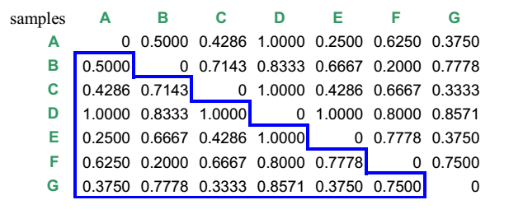
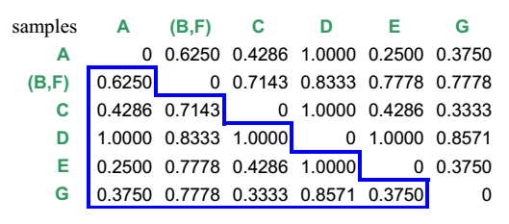
Learning algorithm: Hierarchical clustering
Ex) We have 7 samples; A,B,C,D,E,F,and G
Dissimilarity matrix
B & F are the most similar
Let merge them : (B,F)
Basically going to keep repeating this step,
But, how to calculated the dissimilarity between the merged pair (B,F) and the other samples?
Linkage criterion !
Let consider complete linkage criterion = the dissimilarity between the merged pair and the others will be the maximum of the pair of dissimilarities in each case.
The dissimilarity between B and A is 0.5000 (d(A,B)=0.5), while the d(F,A) is 0.6250.
Therefore, we choose d{(B,F),A)}=0.6250, to quantify the dissimilarity between (B,F) and A.

Slide 37
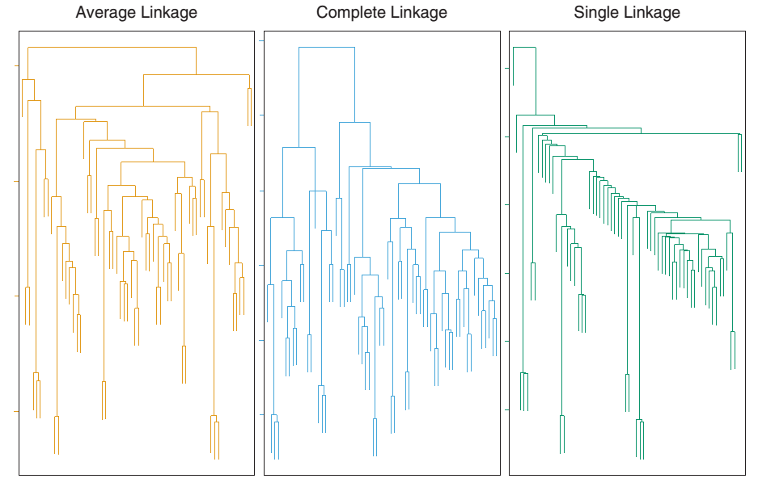
Learning algorithm: Hierarchical clustering

Slide 38
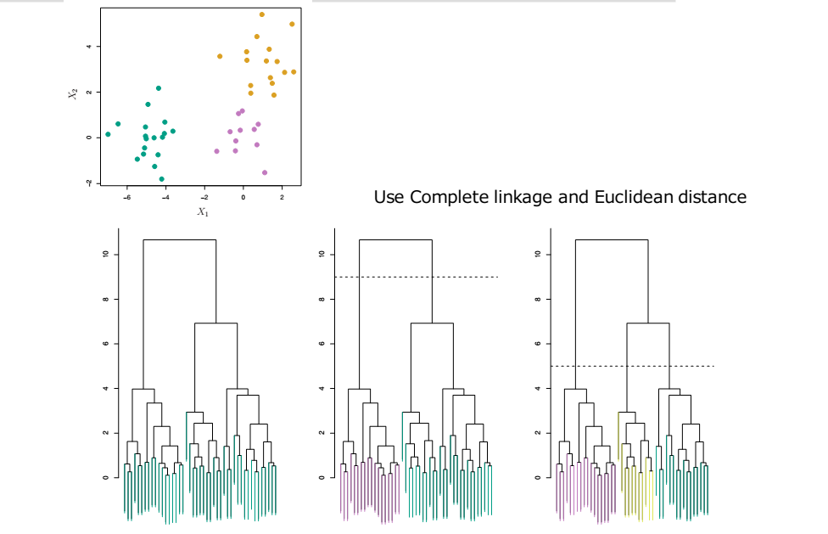
Learning algorithm: Hierarchical clustering

Slide 39
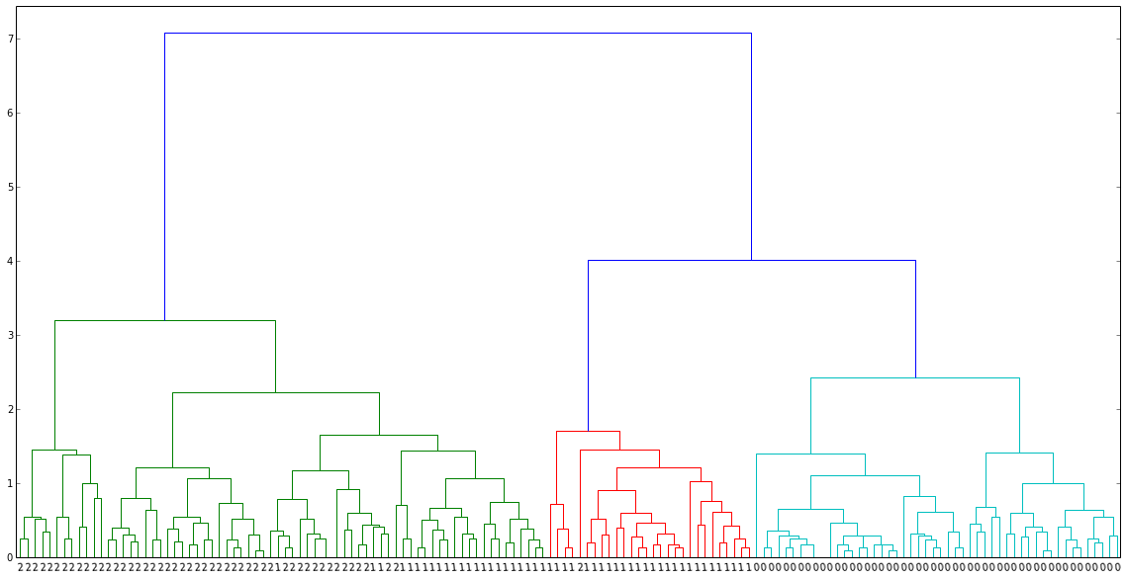
Learning algorithm: Hierarchical clustering
Python example
import numpy as np
from scipy.cluster.hierarchy import dendrogram, linkage
from scipy.spatial.distance import pdist
import matplotlib.pyplot as plt
from sklearn import datasets
iris = datasets.load_iris()
X = iris.data
dist_mat = pdist(X,'euclidean')
linkage_matrix = linkage(dist_mat, "complete")
plt.clf()
plt.figure(figsize=(20,10))
ddata = dendrogram(linkage_matrix, labels= iris.target, color_threshold=4)

Slide 40
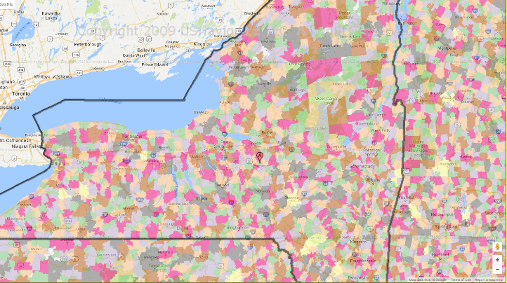
Learning algorithm: Hierarchical clustering
Healthcare example
A hospital plans to analyze which zip codes form distinct contribution margin (CM) groups. They collected CM data for all patients from local area zip codes.
Question: Is it possible to combine some zip codes into a few relatively homogeneous groups (clusters) with similar CM in order to analyze which factors make one group different from other?

Slide 41
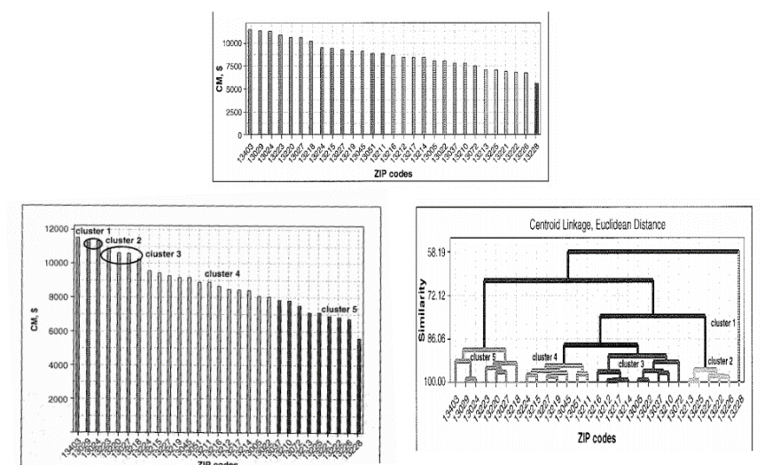
Learning algorithm: Hierarchical clustering

Slide 42
Learning algorithm: Hierarchical clustering
Clustering (unsupervised learning) is useful for discovering inherent structure in data
It is very easy to design a clustering algorithm, but it is very hard to say if it does anything good
General purpose clustering is unlikely to exist, for best results, clustering should be tuned to application at hand
Growing importance in various fields
subgroups of breast cancer patients grouped by their gene expression measurements,
groups of shoppers characterized by their browsing and purchase histories,
movies grouped by the ratings assigned by movie viewers.
Often the unsupervised learning is performed as part of exploratory data analysis

Slide 43
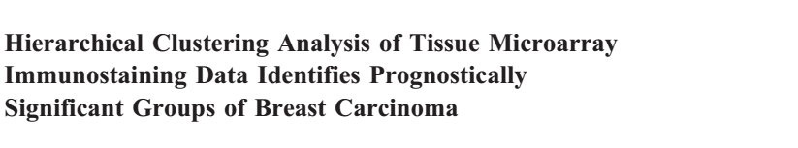
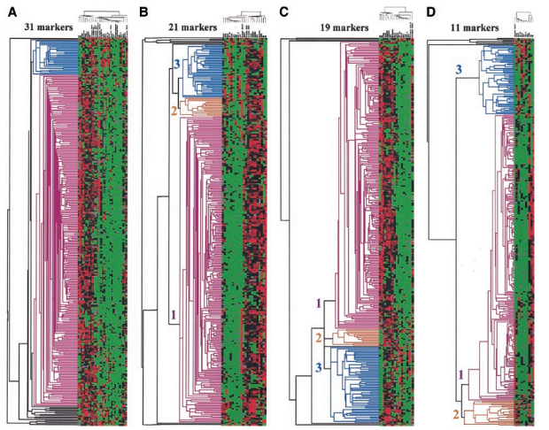
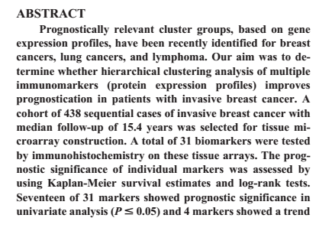
Hierarchical clustering analysis based on gene profile for breast cancer identification

Slide 44
Questions?

